Slide 1
The OXY-LIFELINE®
Designed and Manufactured by
“Your Compressed Gas Equipment Specialists”

Slide 2
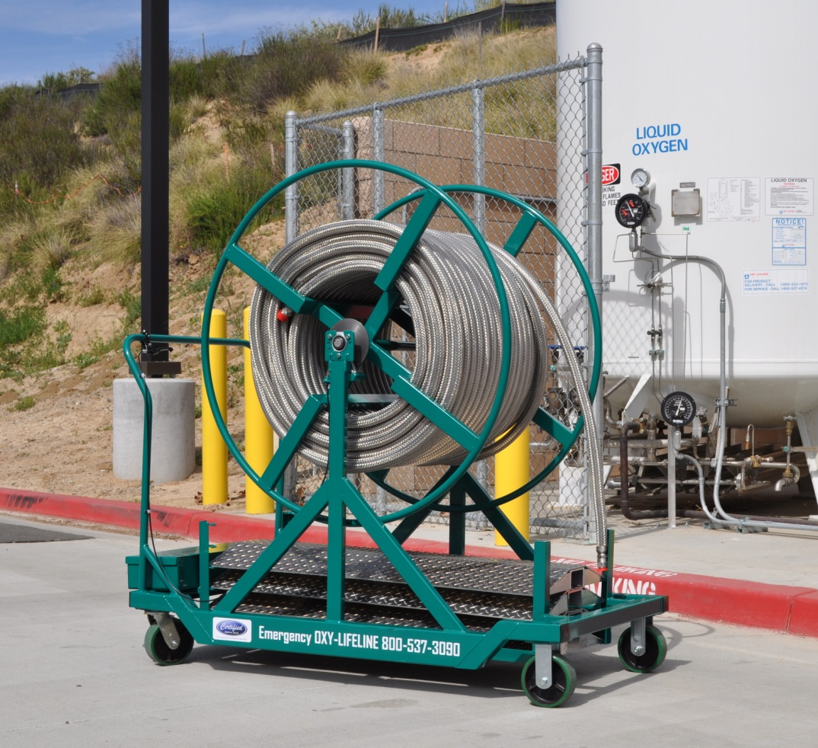
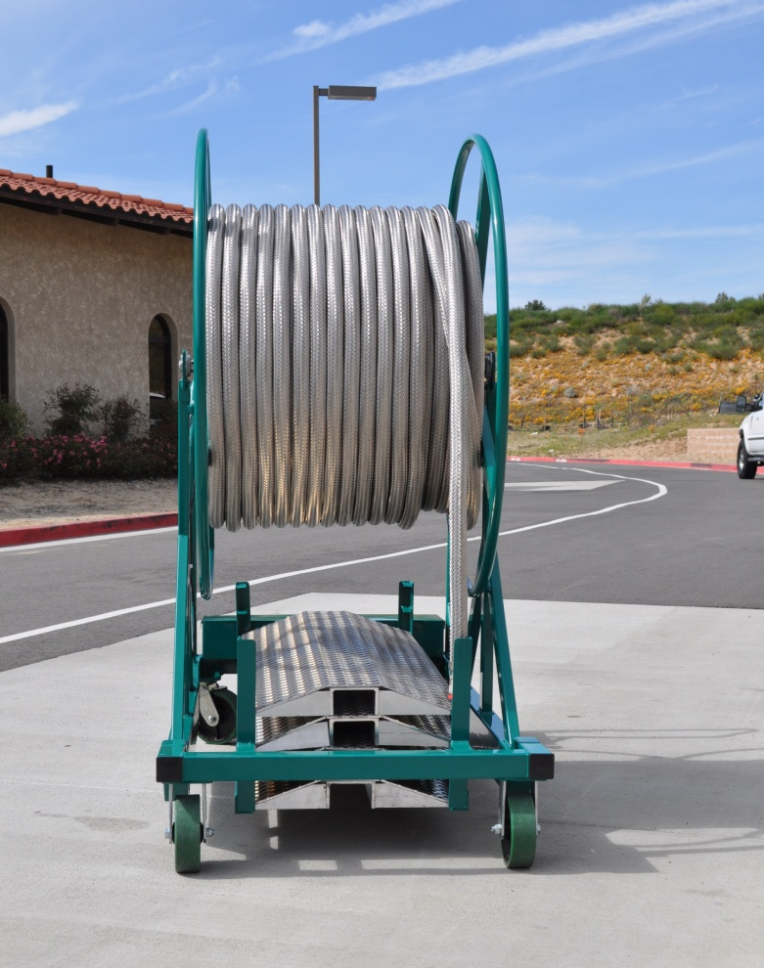
The OXY-LIFELINE® is a rapidly deployable Emergency Back-Up Oxygen System that is primarily used for hospital oxygen systems. It can supply the facility with uninterrupted service by taking advantage of gas supplies that are already on site.

Slide 3
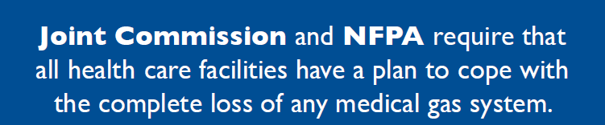

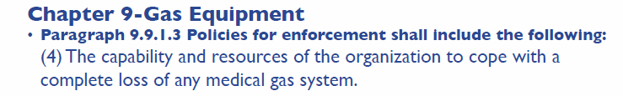
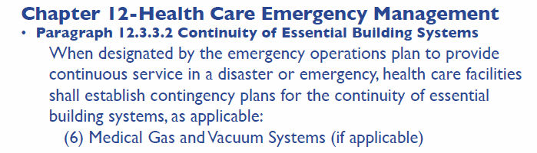
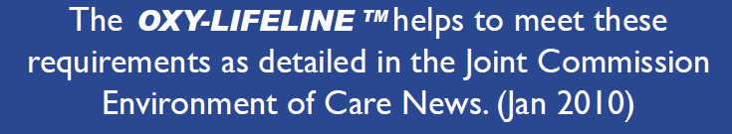

Slide 4
The OXY-LIFELINE® can be utilized for multiple applications, including:
Emergency Oxygen Back-Up Systems
Mass Casualty or Alternate Care Sites Oxygen Distribution
Planned Construction Shutdowns for Oxygen Pipeline
Repairs or Bulk Oxygen Tank change out

Slide 5
Emergency Oxygen Back-Up System application:
If the underground line between the hospital and the remote bulk oxygen vessel were to suffer damage due to a construction mishap, terrorist act or natural disaster the oxygen flow would be compromised to the facility.
Hospital Risk Management, Facilities Management and Respiratory Therapy Staff need to have an Emergency Preparedness Plan that deals with a breach in the underground Main Oxygen Piping. They need to consider the following concerns:
Do they have a plan and system in place to deal with this scenario.
Does their current supplemental medical oxygen system give them more than a few hours of service without being resupplied with costly mobile units.
Does their system allow them to access the ample supplies of gas stored on site in their bulk oxygen vessel.
Can the plan and system be deployed within a matter of minutes.

Slide 6
Hospital staff when questioned with a scenario involving a breach in the under-
ground main line respond with the following:
“We would call our Oxygen Supplier and they will bring a truck out to plug into
our Emergency Low Pressure Inlet”.
The problem with this plan is:
Most suppliers are unaware that the hospital is expecting them to arrive within minutes of the call with a “gaseous oxygen” truck.
If a truck is available within the general area of the facility it could still be a few hours minimum before the truck can arrive with “gaseous oxygen”, and then will it be equipped with the right hoses and fittings to connect immediately to the hospitals “Emergency Low Pressure Inlet”. When this truck is empty of “gaseous oxygen” how
will it be replaced?
3. What will the time delay be for a truck to arrive if this call from the hospital were to come afterhours or on a weekend.
4. This response time even if it is a few hours puts the patients, hospitals and suppliers at risk.
5. This expectation from the hospital is unrealistic.

Slide 7
This is why the OXY-LIFELINE® was designed and developed.
If the hospital has an OXY-LIFELINE® on site:
They can rapidly deploy it within a few minutes utilizing 1 – 2 people
no matter what time of day it is needed.
2. It will allow the facility to operate as normal in an emergency without
straining available manpower by having to relocate patients.
They won’t have to rely on suppliers with portable tanks that may be
hours away.
It can supply uninterrupted service while repairs are made to the main
line.
It can be used and then put back into storage for future needs without
incurring additional expense.

Slide 8
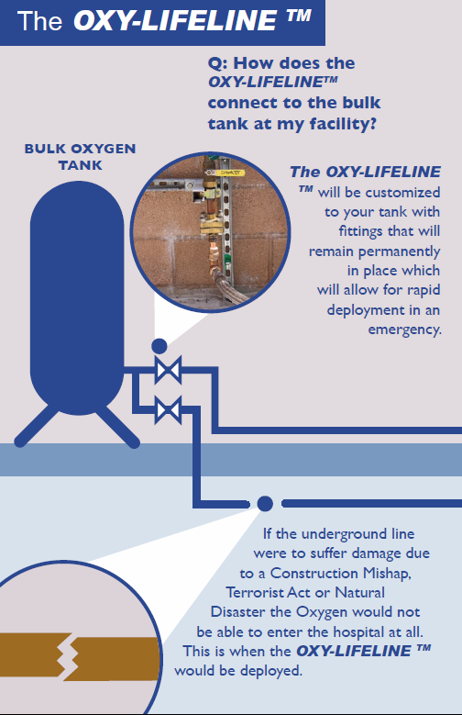
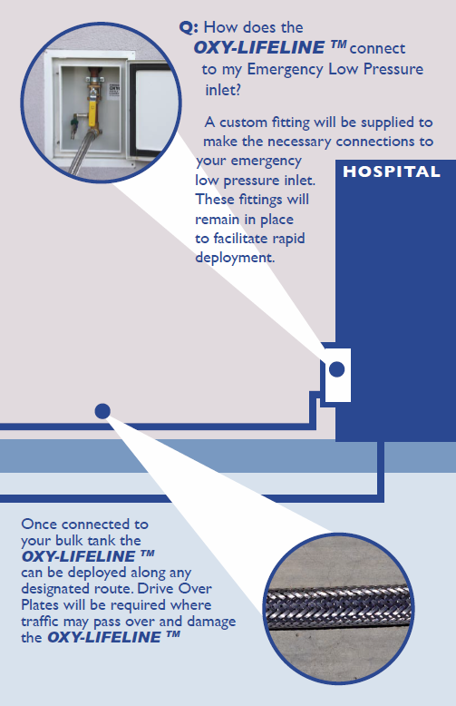

Slide 9
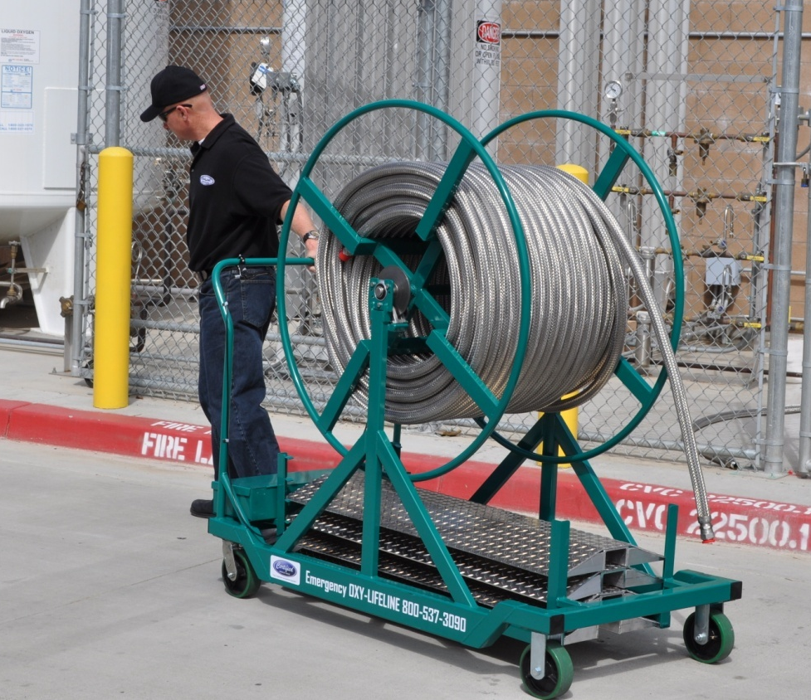
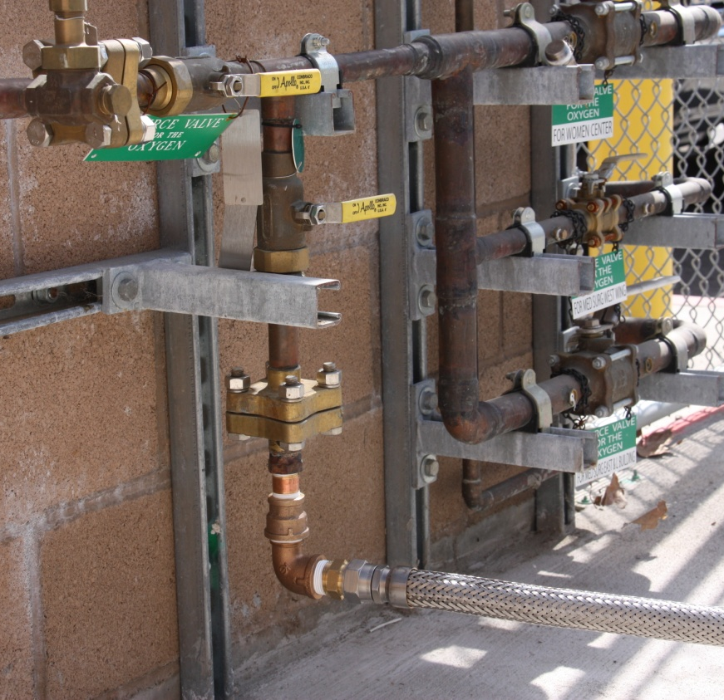
Deploying the OXY-LIFELINE®
Position Roll Out Cart and connect OXY-LIFELINE® to prepared valve at Bulk Oxygen Vessel

Slide 10
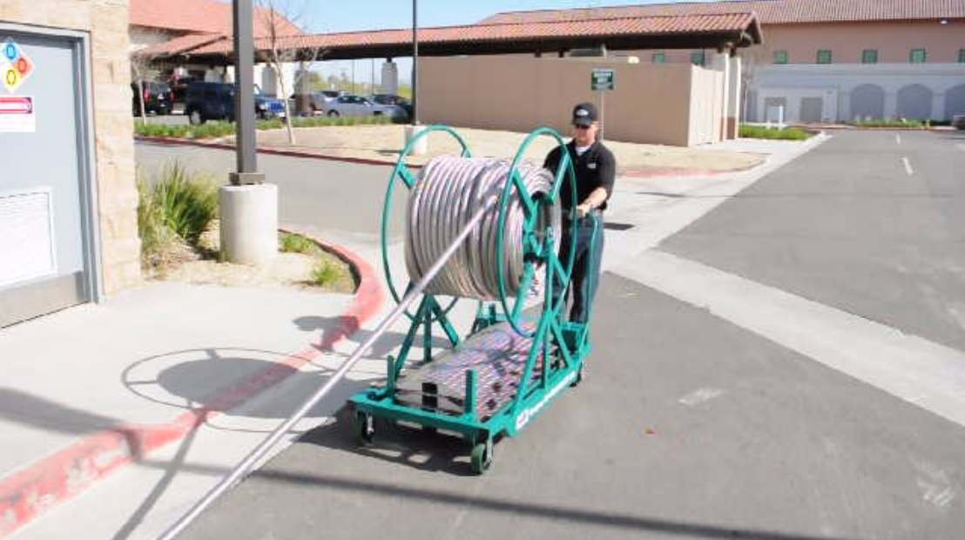
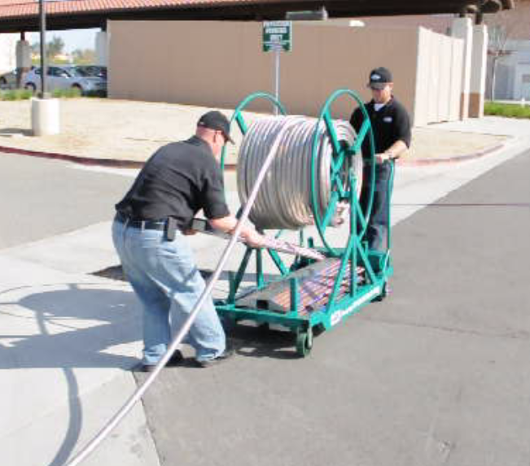
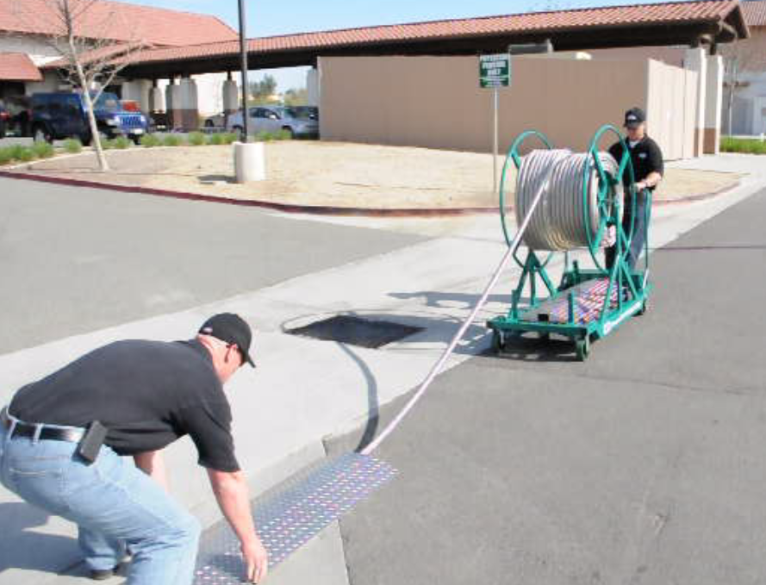
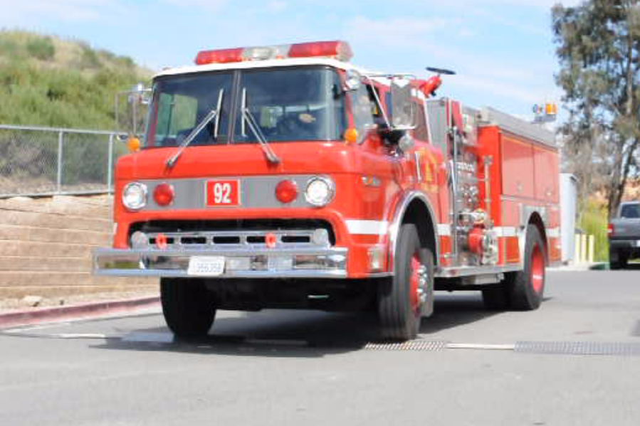
Easily deployed and protected with interlocking drive over plates

Slide 11
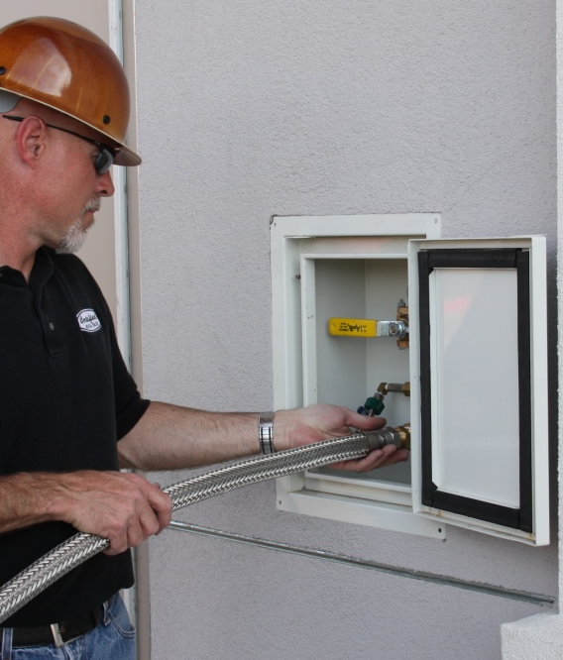
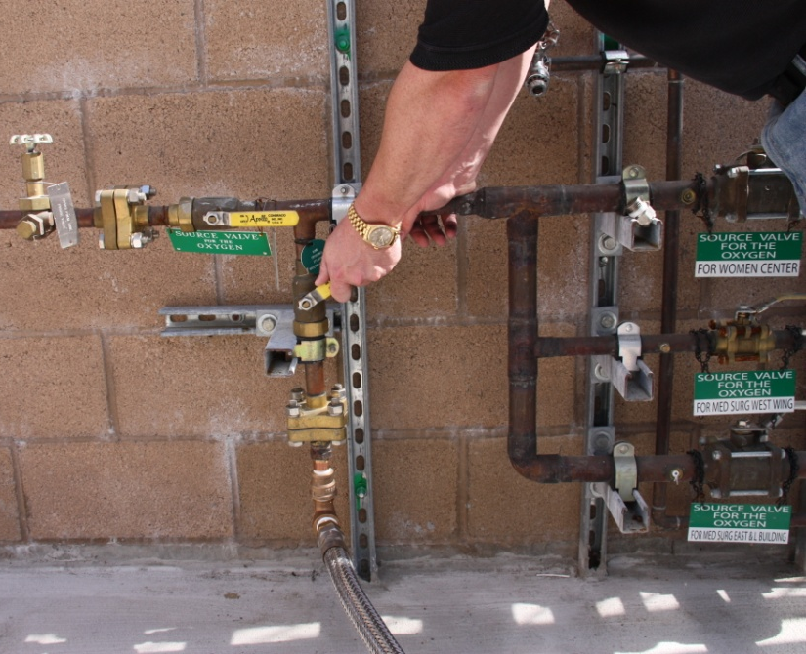
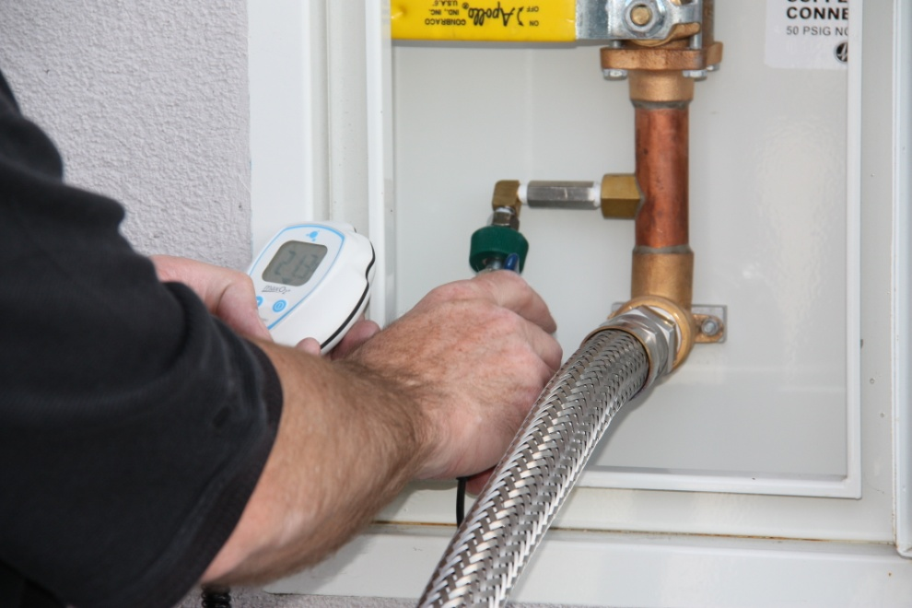
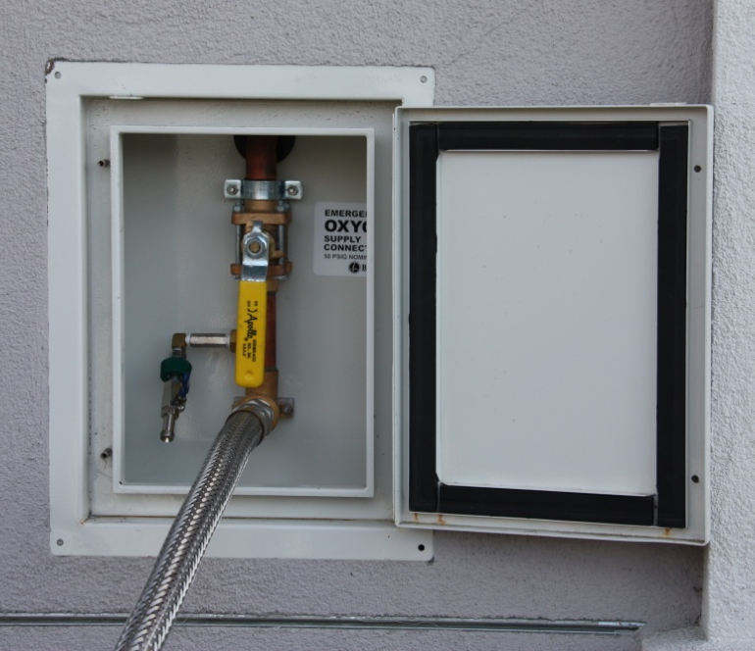
Connect to the Emergency Low Pressure Inlet, pressurize line, check for percentage of oxygen, open valve to allow the OXY-LIFELINE® to supply the facility.

Slide 12
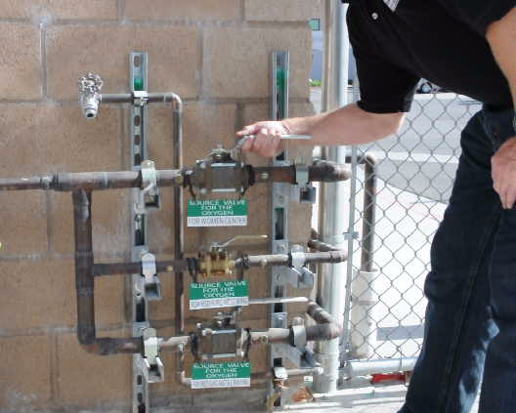
Secure the main line valve for the breached oxygen line
With the OXY-LIFELINE® in place we have re-established flow from the Bulk Oxygen Tank to the facility. Now repairs can be made without jeopardizing patient safety.

Slide 13
Mass Casualty or Alternate Care Sites Oxygen Distribution:
It is no longer a question of “if”, but “when”. Healthcare and emergency response organizations must prepare for disasters and mass casualty events. As shown by the tragedy of September 11, 2001 and predictions of natural emergencies such as the avian flu pandemic, tornados, hurricanes, and earthquakes victims and patients ranging from infant to adult could number in the thousands – and studies routinely predict shortages in equipment and consumables.
The OXY-LIFELINE® is the perfect solution to be able to feed oxygen from the bulk oxygen tank to the Mass Casualty Site. Using the custom built Interface for Patient Connection Block and the OXY-LIFELINE® the facility will be able to rapidly provide oxygen to the patients for an extended period of time without the burden of changing out empty cylinders.
The OXY-LIFELINE® can be used simultaneously for Mass Casualty and supplying the facility should an emergency need arise.
Funds may be available from Federal, State, Foundation and even Corporate Sources. Consider contacting local Health Departments for funding opportunities or contact the nearest Metropolitan Medical Response System office.

Slide 14
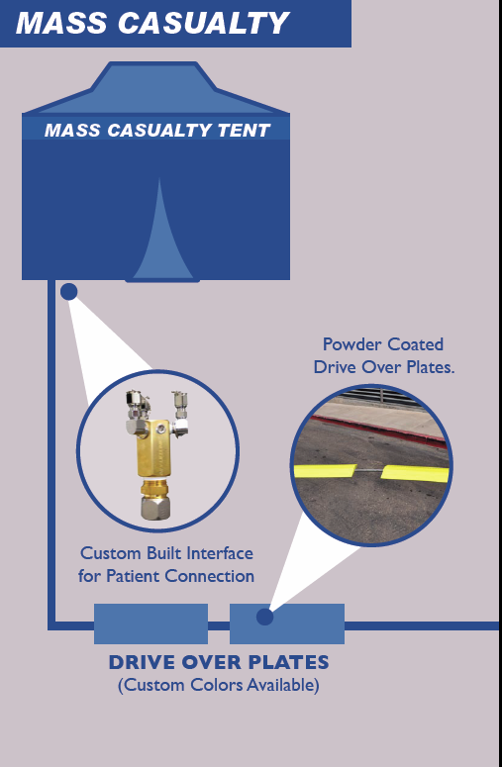
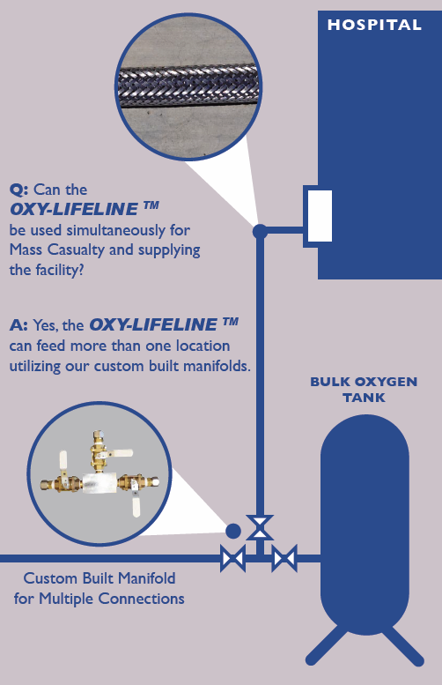

Slide 15
Planned Construction Shutdowns for Oxygen Pipeline Repairs or Bulk Oxygen Tank
change out:
The OXY-LIFELINE® is the perfect tool for hospitals that are undergoing construction
or need to make a repair to their underground mainline for their Oxygen Systems.
The OXY-LIFELINE® provides an above ground alternate route for the oxygen which allows the underground piping to be repaired or modified.
Benefits:
Rapidly Deployable by 1-2 personnel
Utilizes on-site Oxygen Source
No need to bring in a Truck, Tank or Additional Gas Supplies
Can be used for an extended period of time without continuous monitoring and
support
The OXY-LIFELINE® was recently used by a hospital in San Diego that needed to repair
a 3” valve that was leaking, 6 weeks after this repair was completed they employed the OXY-LIFELINE® again to provide Oxygen to two separate buildings while a 70’ section of mainline was replaced.

Slide 16
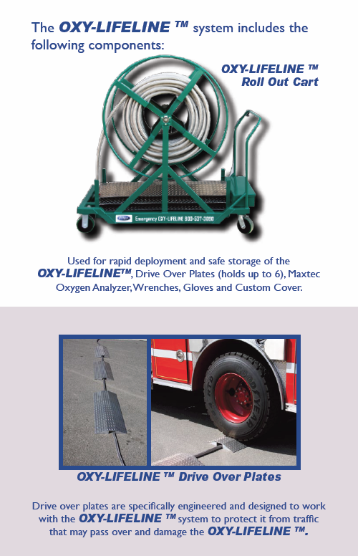
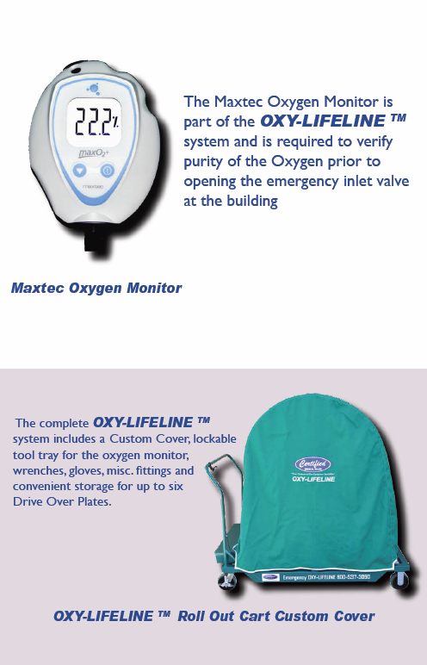

Slide 17
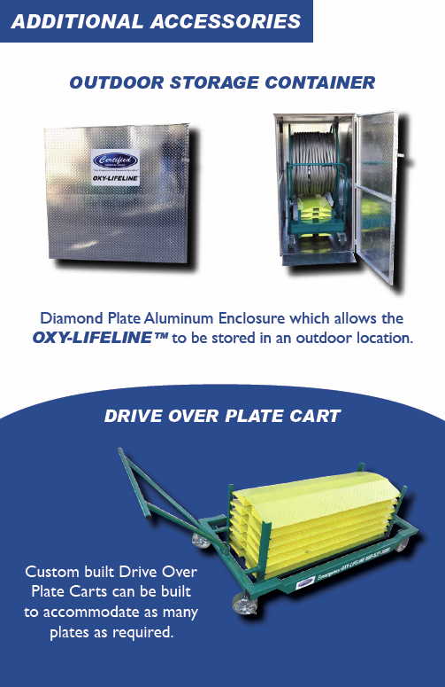
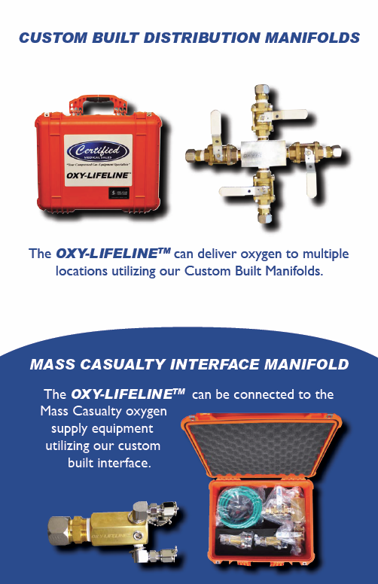

Slide 18
